Slide 1
Wildfire Risk Management
Puget Sound Energy
Carryn Vande Griend
Local Government Affairs
May 2026

Slide 2
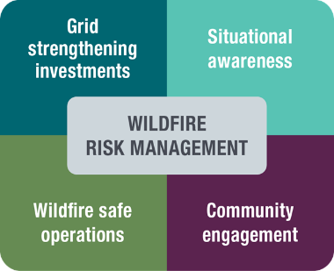
Wildfire Risk Management Program
Investing in projects to strengthen our infrastructure
Utilizing real-time data and new technologies to enhance our situational awareness
Operating the electric system more conservatively during wildfire season to keep communities safe
Partnering with emergency responders, local organizations and our customers to build more resilient communities
Read PSE’s Wildfire Mitigation Plan: PSE.com/Wildfire

Slide 3
Working year-round to reduce wildfire risk
Strengthening the grid
Replacing and upgrading equipment, including replacing poles, installing "tree wire" and strategically undergrounding power lines.
Vegetation management
Trimming or removing hazardous trees and vegetation that grows too close to power lines, annually on high-risk lines.
Pre-season patrols and maintenance
Inspecting high-risk lines annually to identify damage that may have occurred during winter storm season and perform maintenance before wildfire season.
April 2026

Slide 4
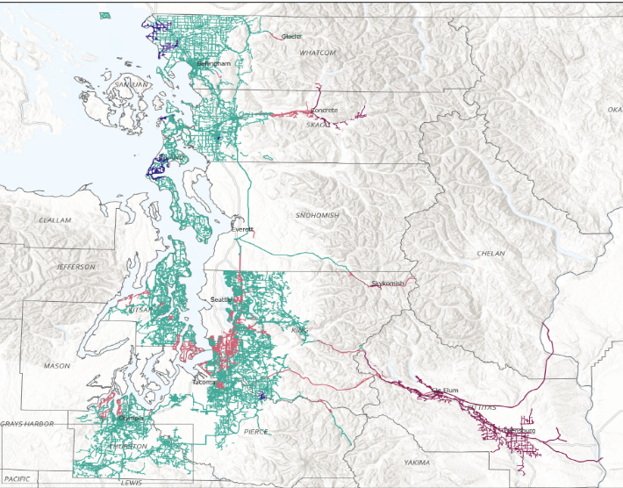
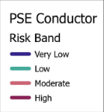
2026 PSE electric system risk bands (based on Technosylva “High Fire Threat” index)

Slide 5
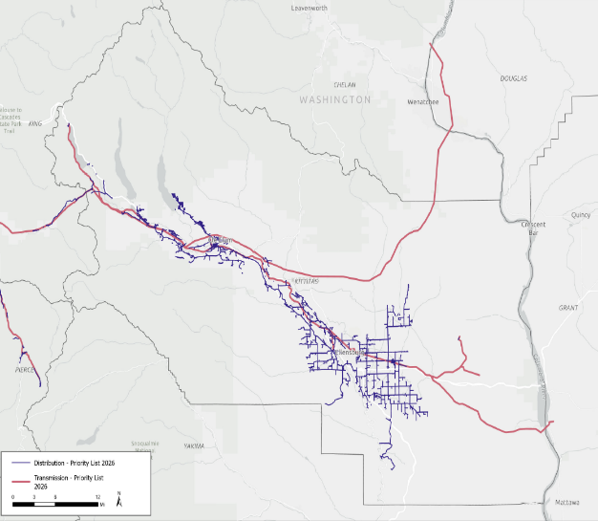
Wildfire Risk Management Kittitas County Priority Lines 2026

Slide 6
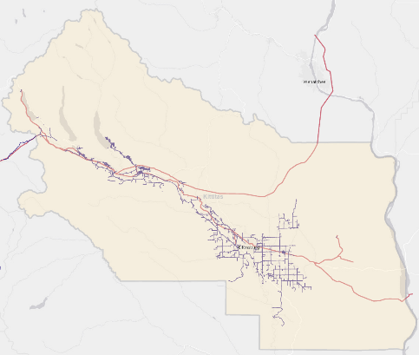
Wildfire Risk Management Community Profile Kittitas County
Future Undergrounding Project Highlights
Highway 903: ~2.5 miles in Ronald and 0.83 miles in Roslyn Denmark Road: ~0.36 miles Cooke Canyon Road: ~3.6 miles Thorp Prairie Road: ~1.84 miles Woodes & Steele Road: ~0.9 miles
1
2
3
4
1
5
5
Recent Wildfire Project Highlights
Situational Awareness | 15 weather stations 7 Pano AI smoke-detecting cameras 298 Gridscopes
Grid Strengthening | 3.8 miles of undergrounding in 2025 >800 miles of wildfire priority patrols in 2025 ~$20M of 2025 Grid Strengthening investment in Kittitas County
4
3
Legend
Priority Distribution Circuit
Priority Transmission Line
Smoke-detecting Camera
Weather Station
Planned Project Highlight
2
#

Slide 7
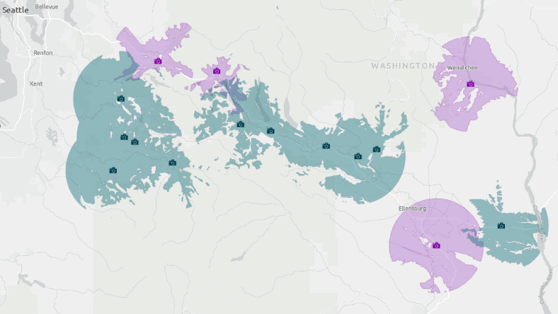
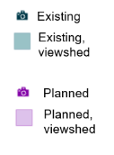
PSE Pano cameras (Central Washington)

Slide 8
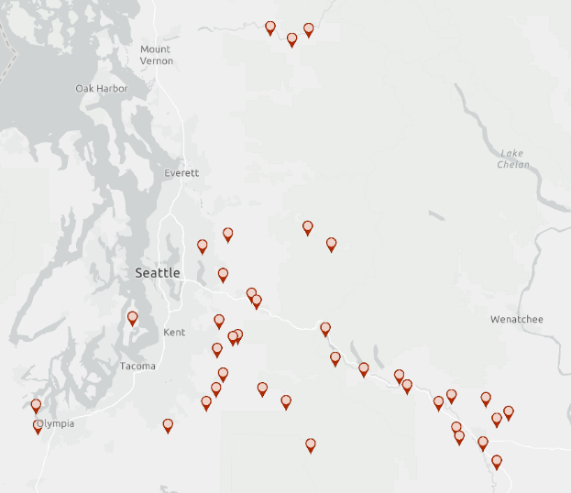
PSE weather stations

Slide 9
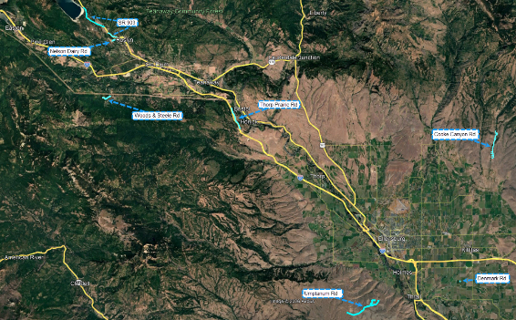
Kittitas County Undergrounding Projects 2026

Slide 10
Wildfire safe operations
PSE wildfire season declaration
A timeframe with increased potential for wildfire activity where PSE operates the grid more conservatively to reduce wildfire risk.
Enhanced Powerline Settings (EPS)
Changing automated settings to help prevent sparks, which turns power off faster when there is a potential hazard in the line (like a tree branch).
Public Safety Power Shutoff (PSPS)
Proactively shutting power off during critical fire weather conditions to prevent wildfires.

Slide 11
Enhanced Powerline Settings (EPS)
During high-risk conditions, PSE uses Enhanced Powerline Settings on targeted lines to make the electric system more sensitive to potential hazards, such as a tree branch touching a line.
EPS keeps you safer by turning power off faster to prevent sparks, but you may experience unplanned power outages when these settings are in place.
Any resulting outages are unplanned and are different than a Public Safety Power Shutoff, where PSE shuts power off proactively in advance of severe weather.
Check the Outage Map for more information or to report a power outage.

Slide 12
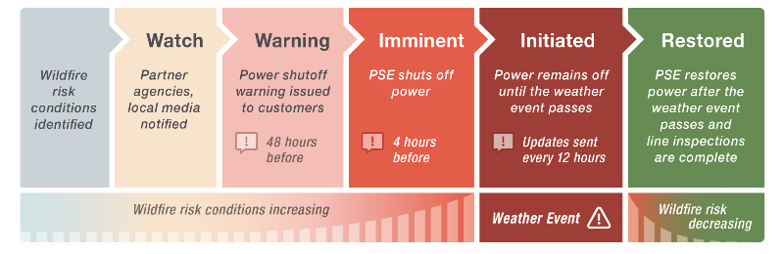
Public Safety Power Shutoff
Goal: First notification 2 days before a shutoff begins
Medical Life Support customers receive enhanced communications
Automated call, text and/or email updates (based on account preference)
Find updates on our Outage Map or at PSE.com/Alerts

Slide 13
PSPS emergency response partner coordination
Department of Commerce-led briefing with emergency response partners.
Partner alerts and ongoing updates to fire districts, critical facilities, local governments, and community support organizations.
Twice daily Situation Reports throughout the event.
Coordination with Emergency Management offices and other first responders on potential public safety issues and locations for PSE Community Resource Centers.

Slide 14

Customers with Life Support status noted in their PSE account will receive phone calls from Customer Care, in addition to regular customer notifications, in advance of a PSPS
Learn more about Life Support status eligibility and how to apply: PSE.com/Medical
Life Support Status is not a guarantee of service, and we strongly encourage customers to have an emergency plan in place and consider backup power for critical equipment
If you have critical medical equipment at home that relies on electricity, please contact PSE Customer Care at 1-888-225-5773 to learn the steps for adding Life Support status to your account.

Slide 15
Be prepared
Update your info
Make sure your PSE account contact information is up to date and sign up for Life Support status if you qualify by calling 1-888-225-5773
Have a plan and supplies
Create and practice a family emergency plan, build an emergency kit, and learn how to prepare when a PSPS is possible at PSE.com/PSPS
Find outage updates
Visit our outage map at PSE.com/Outages to see potential shutoffs, current power outages, estimated times for restoration, or to report an outage

Slide 16

Take steps now to prepare for wildfire season!
Sign up for county emergency alerts and learn more about neighborhood or community emergency response plans
Be aware of fire weather warnings, burning restrictions, and any current fire activity or evacuation orders
Find resources for emergency preparedness: RedCross.org
Maintain trees and other vegetation on your property and report danger trees near power lines to a PSE Arborist: PSE.com/Trees
Get your free Wildfire Ready Plan and take action to make your home and community more resilient: WildfireReady.DNR.WA.gov

Slide 17
Questions?
More information:
PSE.com/Wildfire

